Slide 1
Comparative genome analysis of Scutellaria baicalensis and Scutellaria barbata reveals the evolution of active flavonoid biosynthesis
Zhichao Xu^{1,2}, Ranran Gao¹, Xiangdong Pu¹, Rong Xu^{1,2}, Jiyong Wang³, Sihao Zheng³, Yan Zeng³, Jun Chen^{1,2}, Chunnian He^{1,2}, and Jingyuan Song^{1,2}
¹Key Lab of Chinese Medicine Resources Conservation, State Administration of Traditional Chinese Medicine of the People’s Republic of China, Institute of Medicinal Plant Development, Chinese Academy of Medical Sciences & Peking Union Medical College, Beijing 100193, China
²Engineering Research Center of Chinese Medicine Resource, Ministry of Education, Beijing 100193, China
³China National Traditional Chinese Medicine Co., Ltd, Beijing, 102600, China

Slide 2
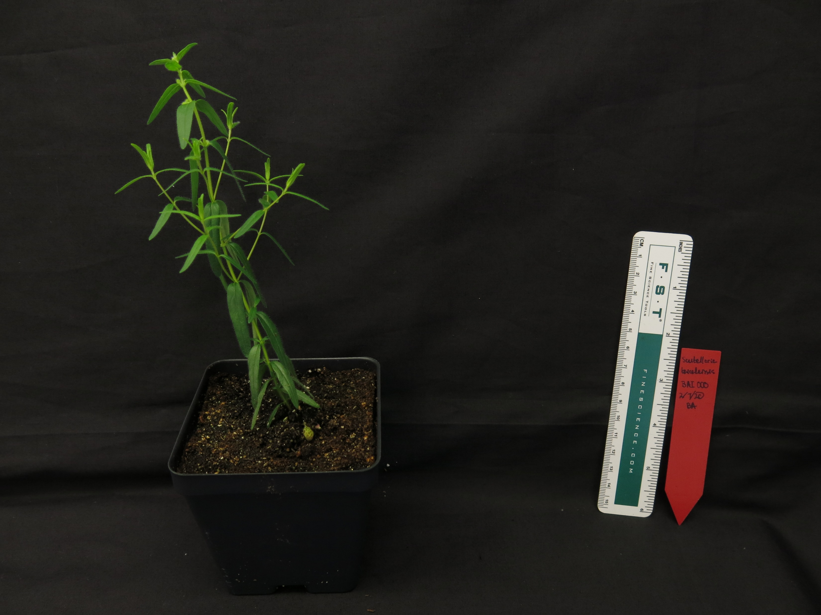
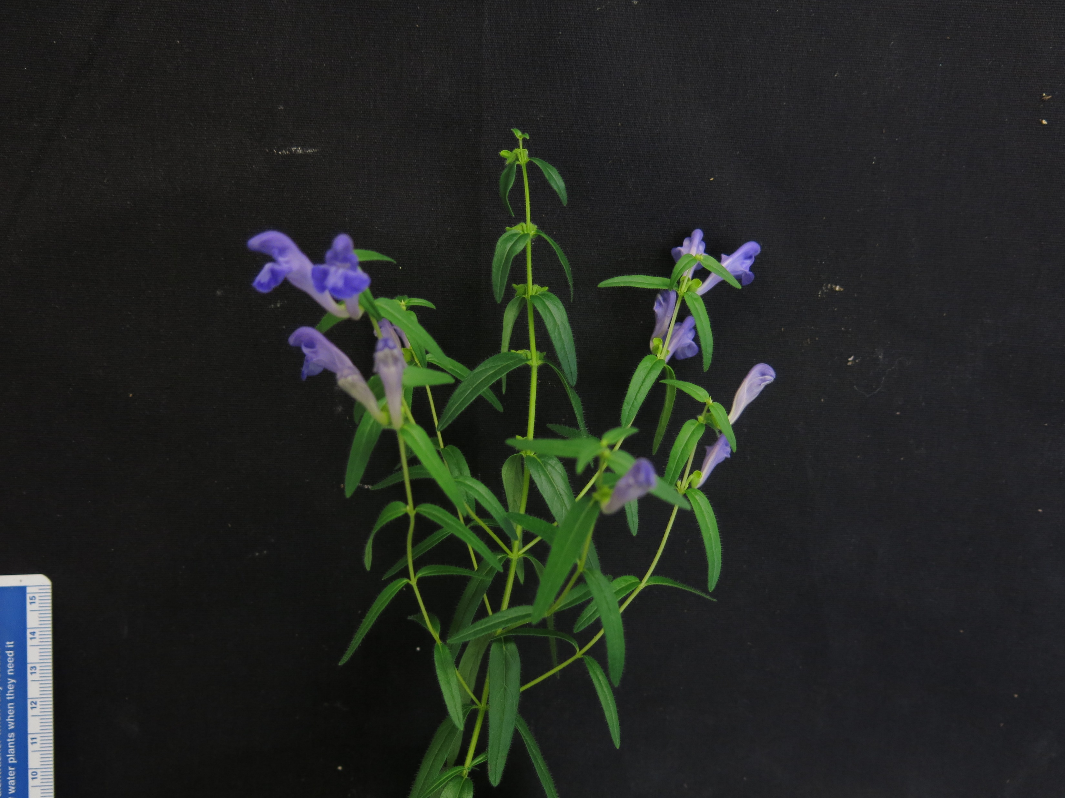
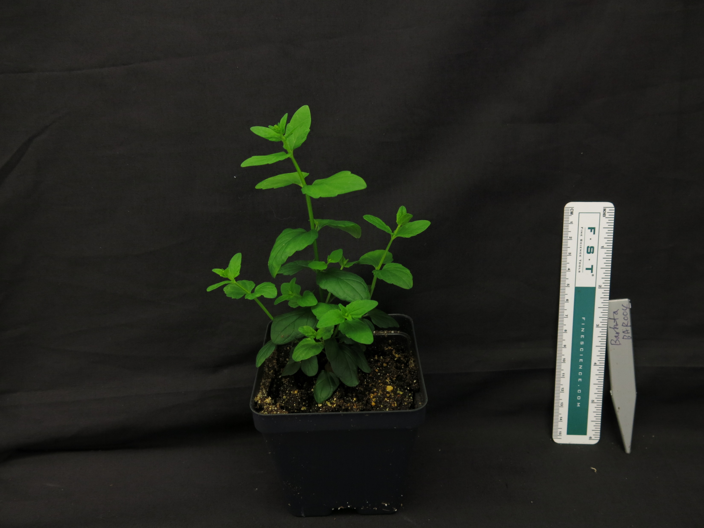
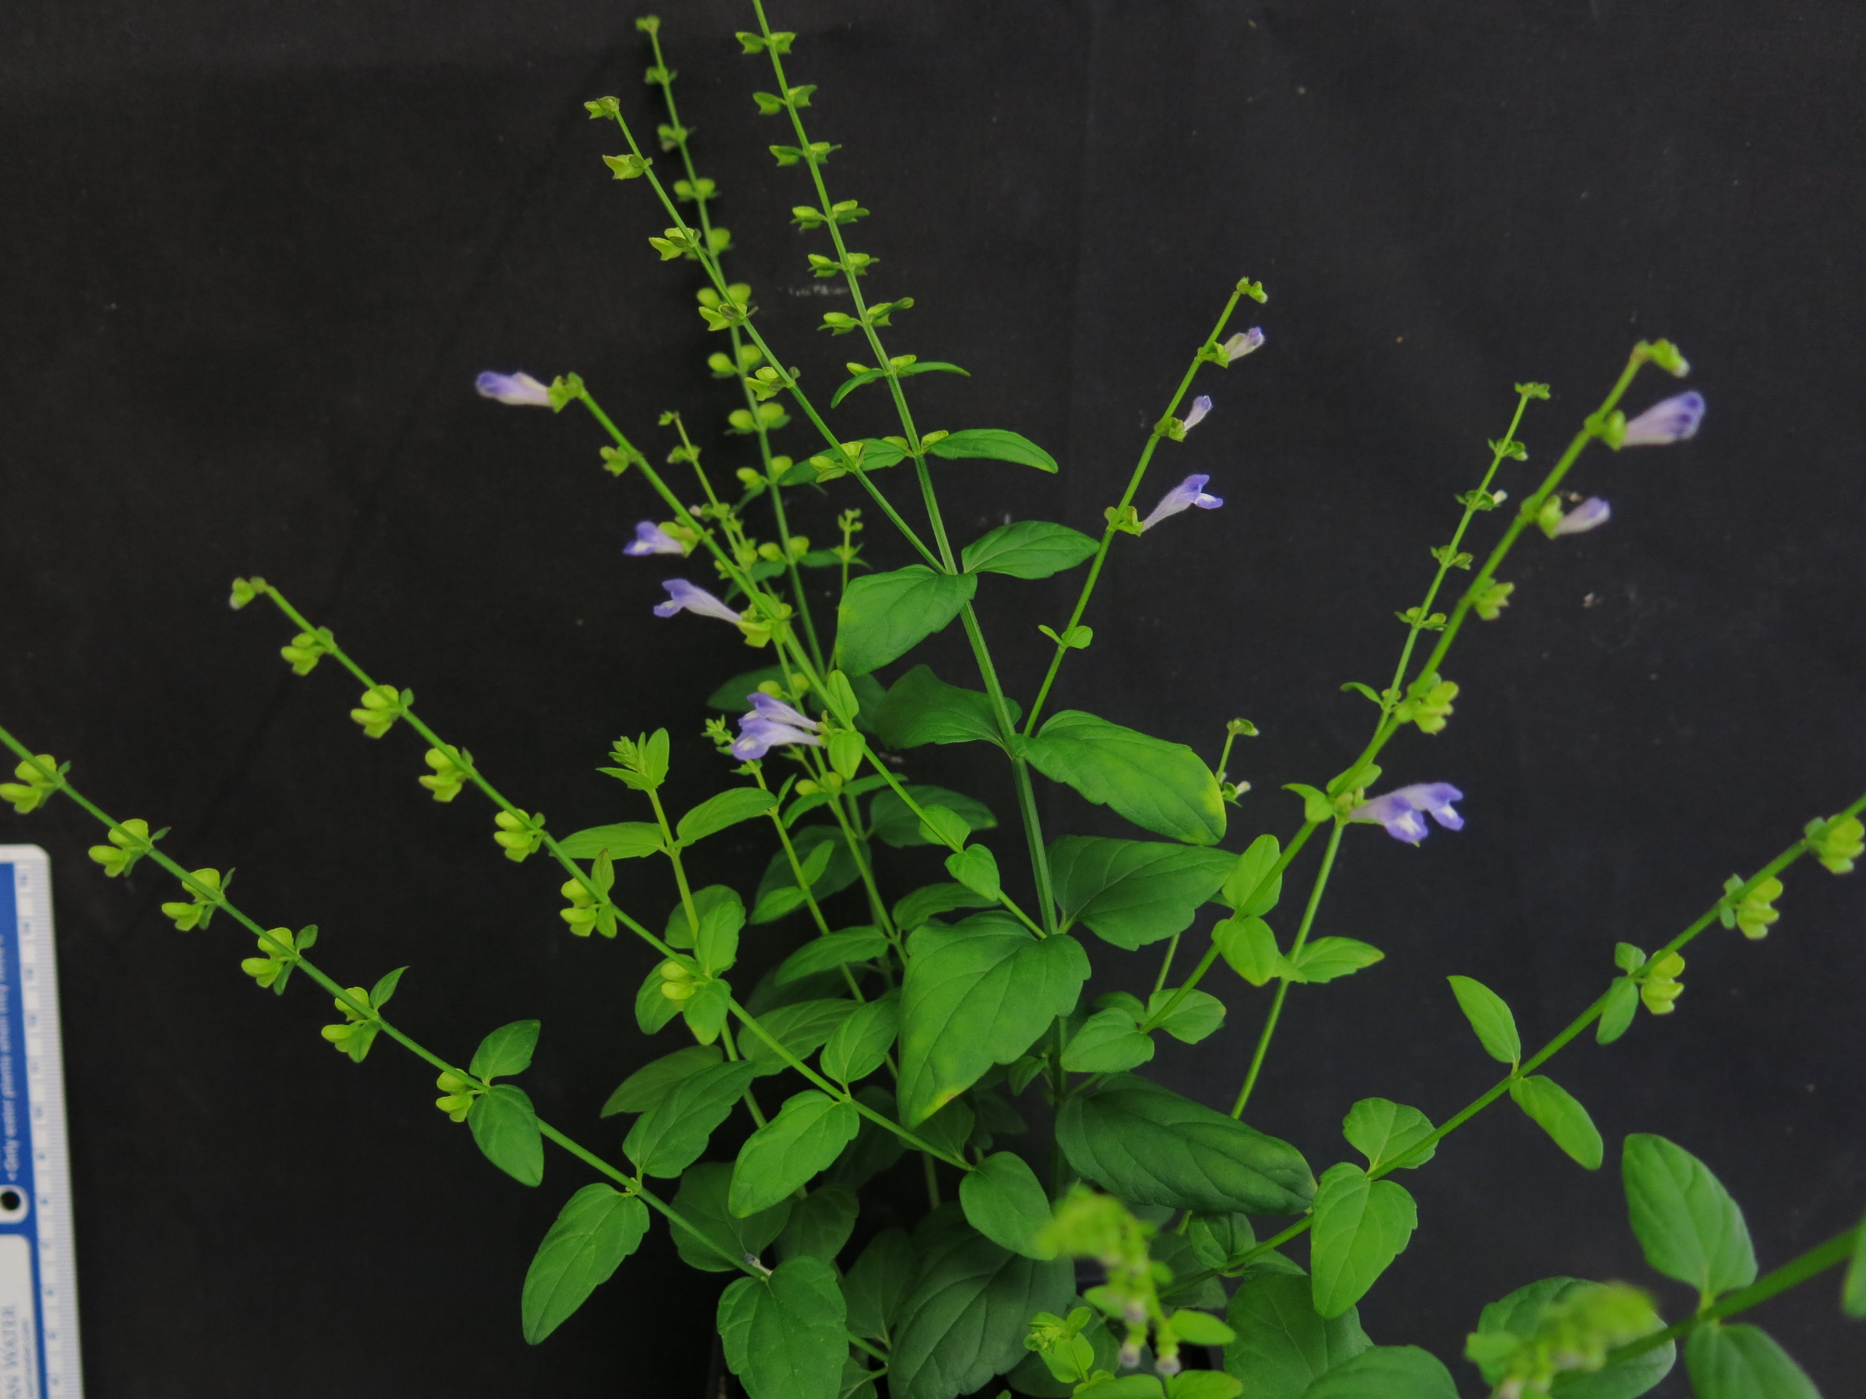
Background
Scutellaria genus is rich in bioactive flavonoids
Baicalein, baicalin
Scutellarein, scutellarin
Wogonin, wogonoside
2 well-known species used in Chinese medicine
Huang Qin – Scutellaria baicalensis roots
Ban Zhi Lian – Scutellaria barbata stems + leaves
Biosynthetic pathway in S. baicalensis has been characterized
S. baicalensis
S. barbata

Slide 3
Overview of study
Chromosome-level genome assembly and comparison –
2. Phylogenetic analysis and deduction of evolutionary history –
3. Similarities in biosynthetic pathway genes –
4. Differences in biosynthetic pathway genes –

Slide 4
Overview of study
Chromosome-level genome assembly and comparison –
Chromosomal number variation illustrates large scale structural variations between S. baicalensis and S. barbata genomes
2. Phylogenetic analysis and deduction of evolutionary history –
3. Conserved evolution of biosynthetic pathway genes –
4. Functional divergence of biosynthetic pathway genes –

Slide 5
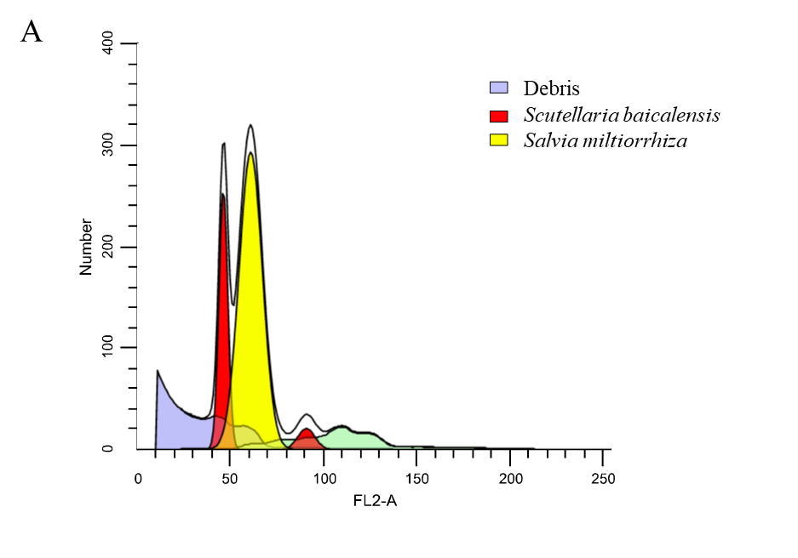
Chromosome-level genome assembly and comparison
Genome sizes estimated with flow cytometry and 21 k-mer distribution analysis
S. baicalensis – 441 Mb
S. barbata – 405 Mb

Slide 6
Chromosome-level genome assembly and comparison
3rd-gen sequencing platforms (ONT and SMRT) used to generate reads, and create contig-level genome assemblies
 | S. baicalensis | S. barbata
17-kmer (bp) | 441,861,814 | 404,561,255
Assembled genome(bp) | 376,971,275 | 352,950,734
Assemble genome / predicted genome | 85.3% | 87.2%
Contig N50 (bp) | 2,102,880 | 2,496,969
Chromosome | 9 | 13
Chromosomal genome (bp) | 376,437,573 | 348,847,092
Scaffold N50 (bp) | 40,790,749 | 23,709,848
DNA mapping (Illumina reads) | 88.72% | 86.13%
RNA mapping (Illumina reads) | 82.97% | 86.56%
BUSCO | C:91.5%,F:2.6%,M:5.9%,n:1440 | C:93.0%,F:2.0%,M:5.0%,n:1440

Slide 7
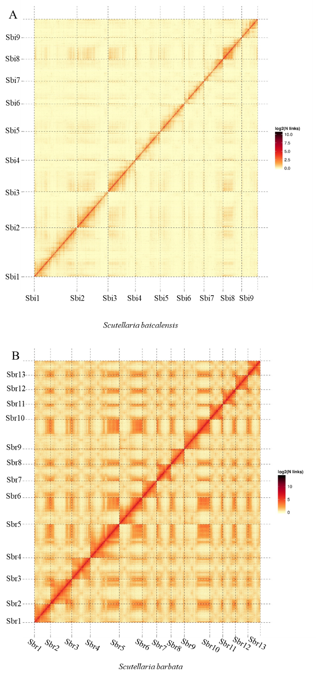
Chromosome-level genome assembly and comparison
Chromosome conformation capture (Hi-C) used to construct chromosome-level genomes

Slide 8
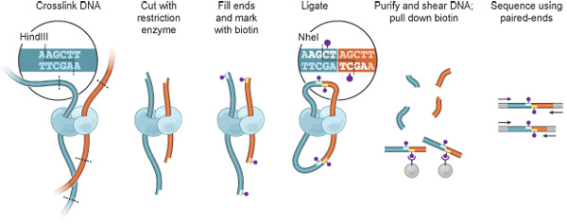
Hi-C overview
https://www.jove.com/video/1869/hi-c-a-method-to-study-the-three-dimensional-architecture-of-genomes

Slide 9
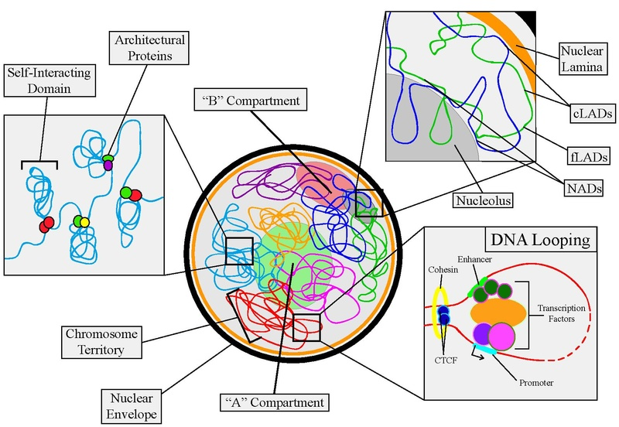
Chromosome-level genome assembly and comparison
Hi-C also used to characterize architectural features of genomes
Interchromosomal interactions
A/B compartments – euchromatin/heterochromatin
https://en.wikipedia.org/wiki/Nuclear_organization

Slide 10
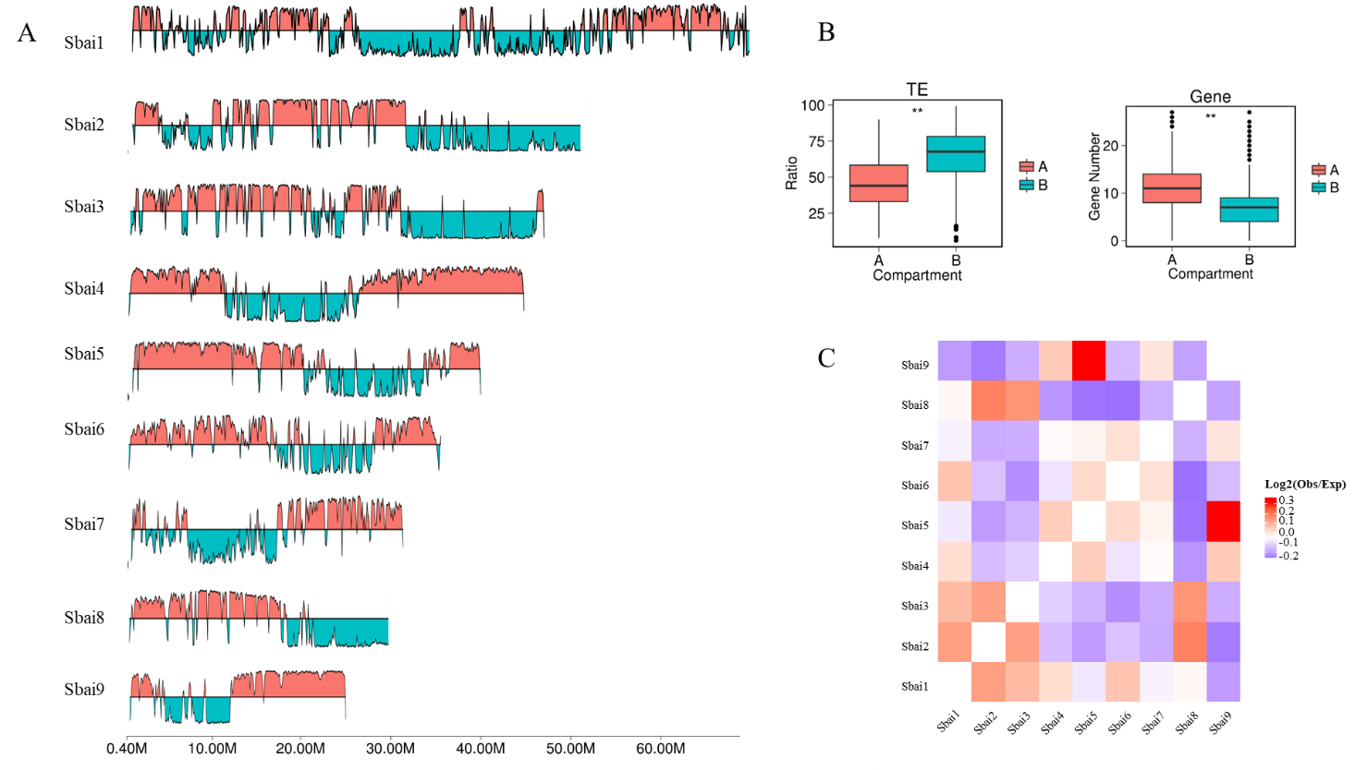
Chromosome-level genome assembly and comparison

Slide 11
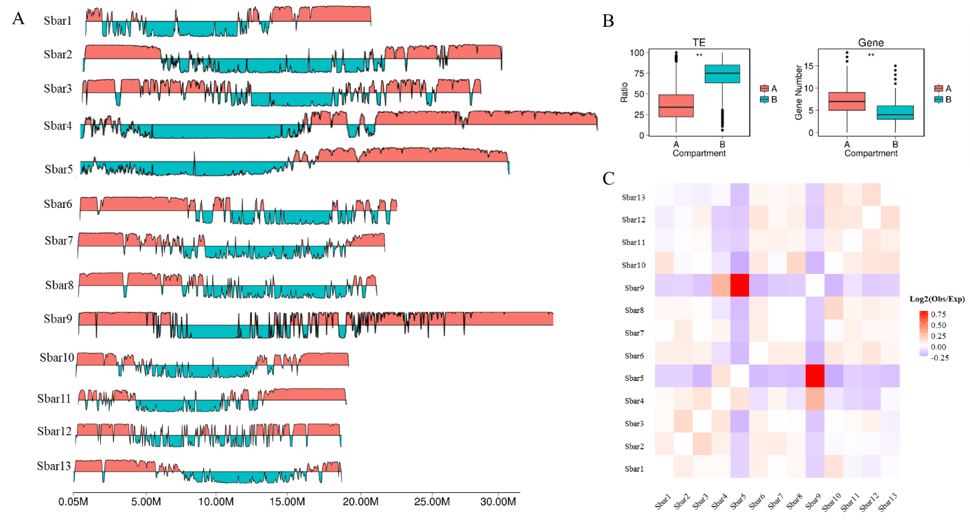
Chromosome-level genome assembly and comparison

Slide 12
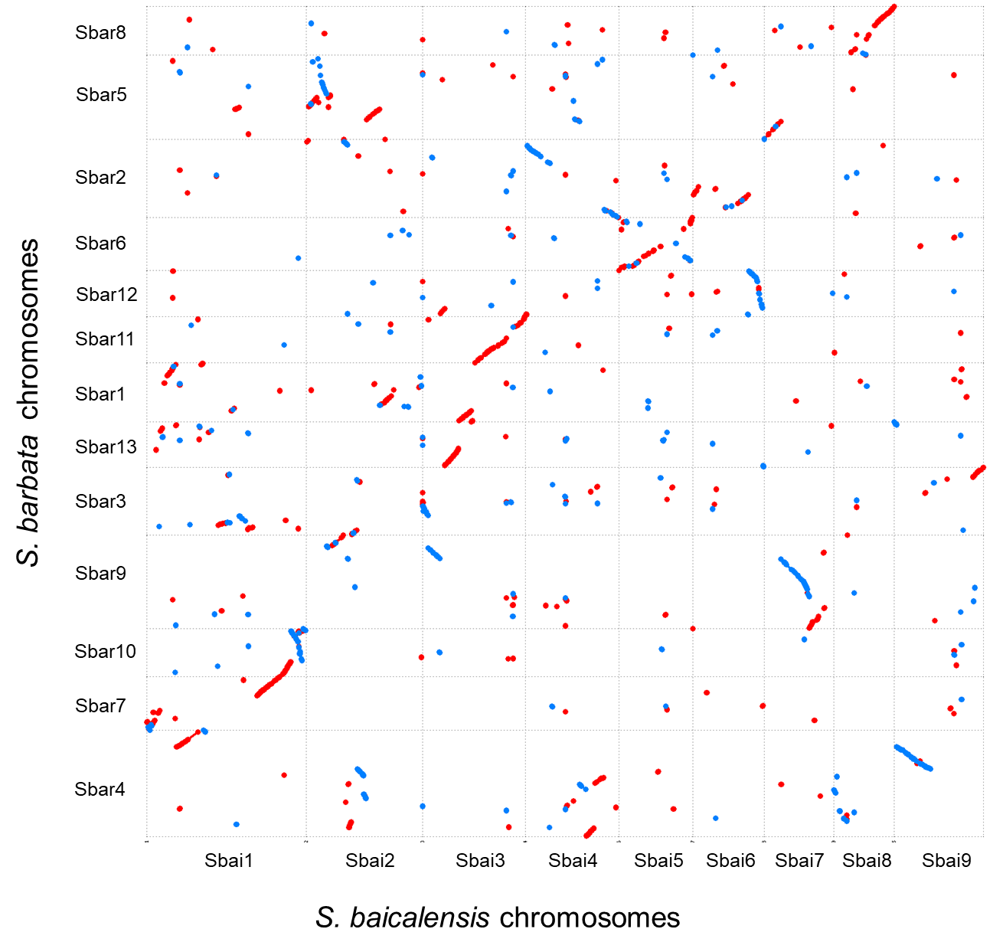
Chromosome-level genome assembly and comparison

Slide 13
Overview of study
Chromosome-level genome assembly and comparison –
Phylogenetic analysis and deduction of evolutionary history –
Divergence time between S. baicalensis and S. barbata was previously underestimated, and a whole genome duplication event is predicted to have occurred prior to divergence
3. Conserved evolution of biosynthetic pathway genes –
4. Functional divergence of biosynthetic pathway genes –

Slide 14
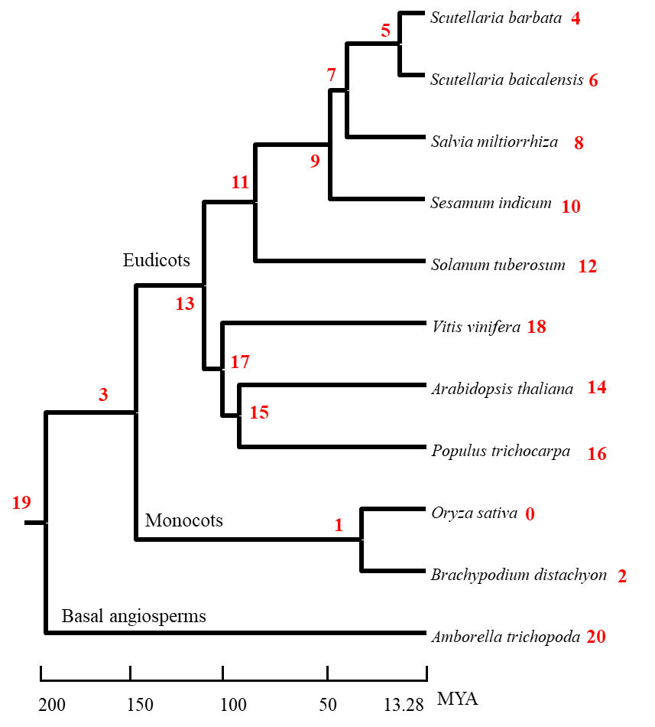
Phylogenetic analysis and deduction of evolutionary history
Phylogenetic tree constructed for 11 angiosperms (including S. baicalensis and S. barbata) from 235 single-copy genes
Divergence time estimated by using published data as reference
Amborella trichopoda and Vitis vinifera – 173-199 MYA
Populus trichocarpa and Arabidopsis thaliana – 98-117 MYA

Slide 15
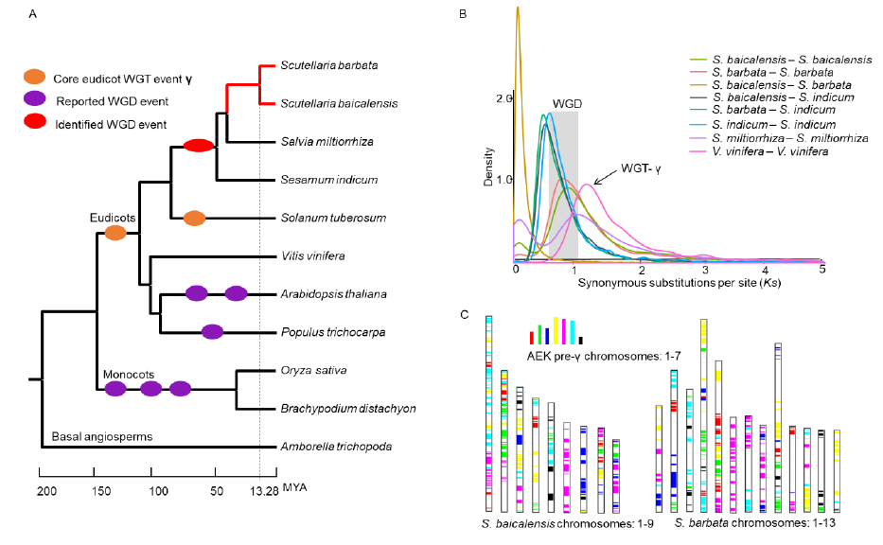
Phylogenetic analysis and deduction of evolutionary history
Differences in synonymous substitution rate provides evidence for approximate time of WGD event

Slide 16
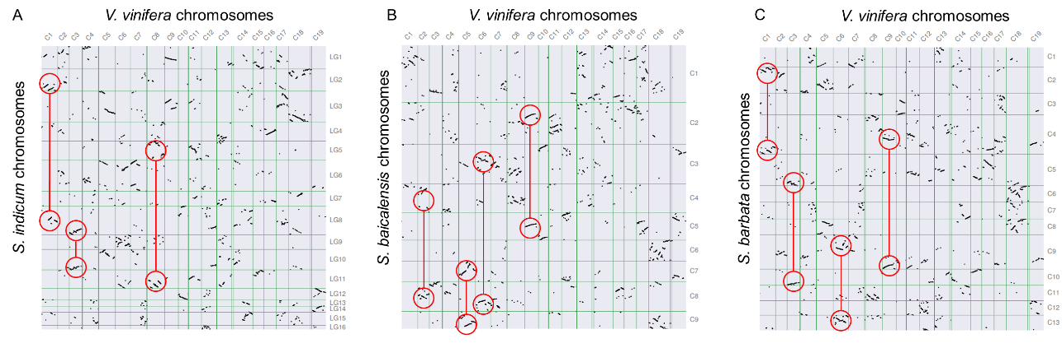
Phylogenetic analysis and deduction of evolutionary history

Slide 17
Overview of study
Chromosome-level genome assembly and comparison –
Phylogenetic analysis and deduction of evolutionary history –
Conserved evolution of biosynthetic pathway genes –
Both S. baicalensis and S. barbata genomes contains all genes necessary to produce bioactive flavones, but differing gene numbers indicate multiple tandem duplication events occurred after divergence
4. Functional divergence of biosynthetic pathway genes –

Slide 18
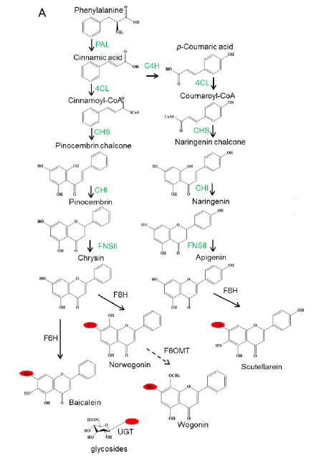
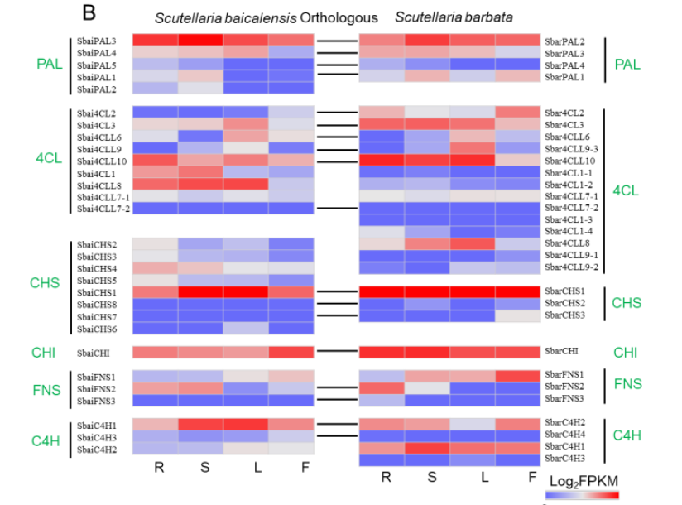
Conserved evolution of biosynthetic pathway genes
Root
Shoot

Slide 19
Conserved evolution of biosynthetic pathway genes
Tandem duplication events following divergence results activation/inactivation of different genes within a family
Number of active genes in a family can alter flavonoid flux through pathway
However, orthologous gene families still serve the same function, regardless of duplication events

Slide 20
Overview of study
Chromosome-level genome assembly and comparison –
Phylogenetic analysis and deduction of evolutionary history –
Conserved evolution of biosynthetic pathway genes –
Functional divergence of biosynthetic pathway genes –
In S. baicalensis, 2 genes are mainly responsible for the hydroxylation of bioactive flavones in the roots. In S. barbata, as a result of structural rearrangement and tandem duplication events, the genes orthologous to these 2 are mainly inactive, and instead, hydroxylation is controlled by 2 non-orthologous genes.

Slide 21
Functional divergence of biosynthetic pathway genes
CYP82D family genes perform key modifications to flavonoids
F8H – hydroxylates chrysin to norwogonin
F6H – hydroxylates apigenin to scutellarein, and hydroxylates chrysin to baicalein
Root
Shoot

Slide 22
Functional divergence of biosynthetic pathway genes
9 CYP82D orthologous gene pairs identified
S. baicalensis: SbaiCYP82D1-9
S. barbata: SbarCYP82D1-9
High expression of SbaiCYP82D1 and SbaiCYP82D2 in roots – strongly correlated with root flavonoids
However, SbarCYP82D1 is expressed primarily in aerial parts and SbarCYP82D2 is barely expressed in any organ
Root
Shoot

Slide 23
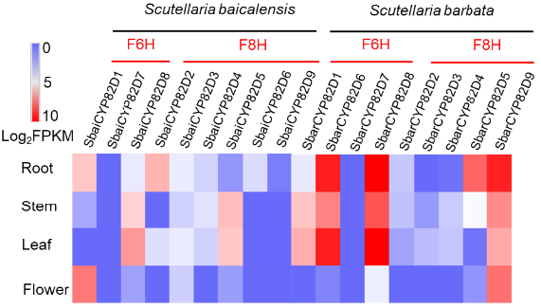
Functional divergence of biosynthetic pathway genes

Slide 24
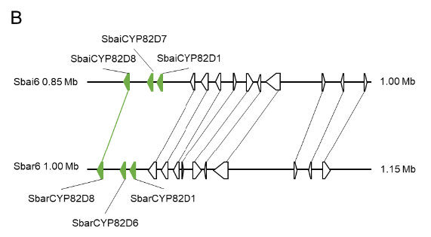
Functional divergence of biosynthetic pathway genes
Collinearity of F6H orthologous genes between chr6 of S. baicalensis and chr6 of S. barbata illustrates:
2 duplications of CYP82D8 prior to speciation produced CYP82D1 and CYP82D7
Another duplication event after speciation occurred specifically in S. barbata to produce CYP82D6

Slide 25
Functional divergence of biosynthetic pathway genes
Differences in F6H function
S. baicalensis – SbaiCYP82D1 and SbaiCYP82D2
S. barbata – SbarCYP82D6 and SbarCYP82D8
Differences in F8H function
S. baicalensis – SbaiCYP82D5
S. barbata – SbarCYP82D5 and SbarCYP82D9

